Slide 1
Sleep Health and Lifestyle
EDA & Key Findings

Slide 2
About The Dataset
The dataset has 374 records after cleaning.
The dataset has measurable features that can be compared against the sleep health features.
Also, the dataset has the categorical features involving different occupation of the people and the sleep disorders.

Slide 3
Data Preparation
Blood pressure split into Systolic and Diastolic columns
Sleep Disorder duplicate values mapped against Healthy
BMI categories standardized

Slide 4
Key Findings…

Slide 5
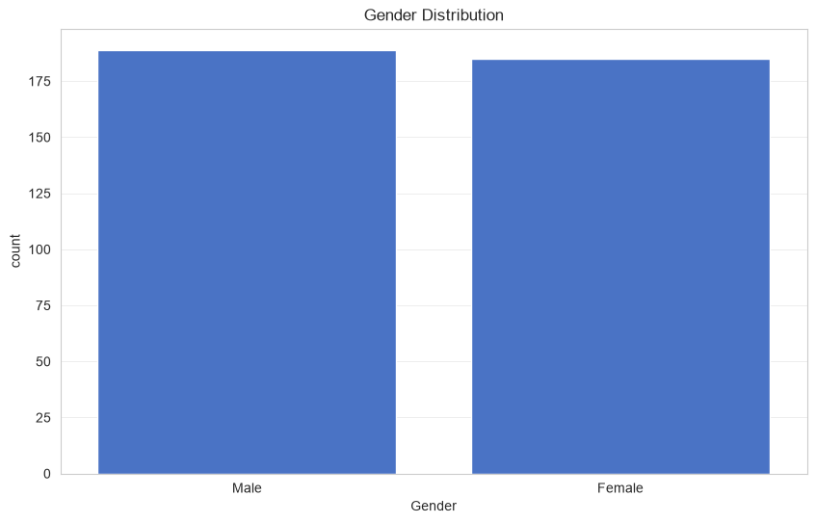
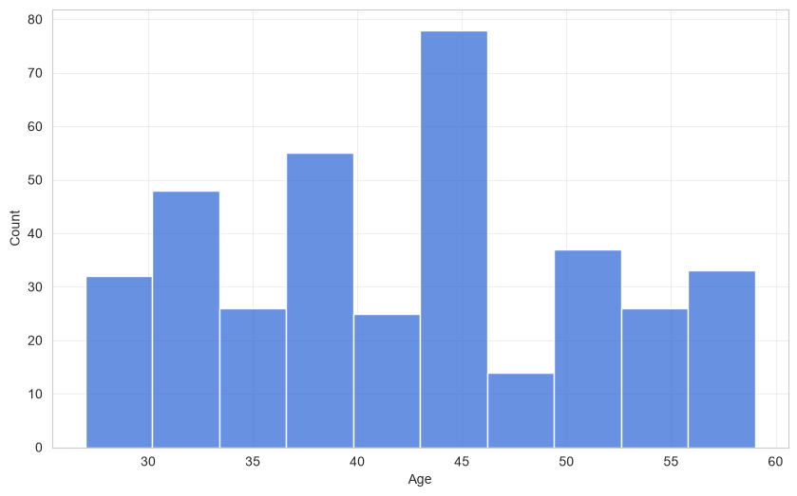
Age & gender distribution
Gender distribution is nearly balanced
Age spread covers adult population broadly
Dataset suitable for comparative analysis

Slide 6
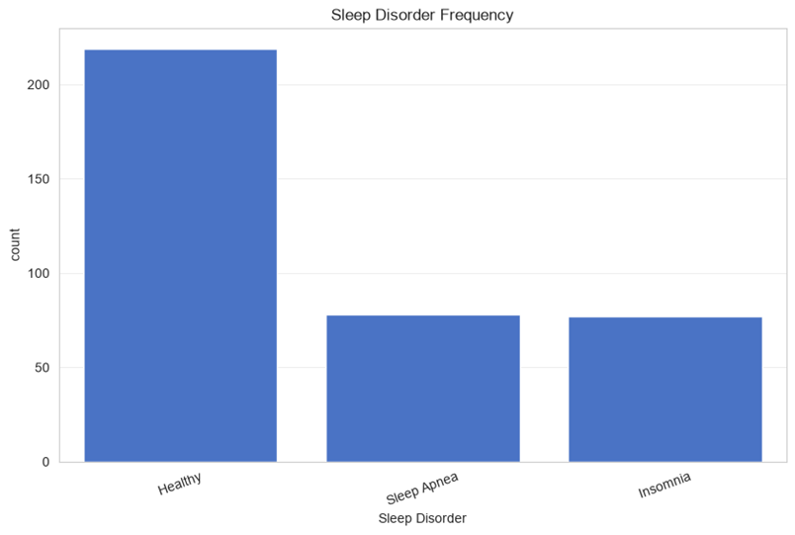
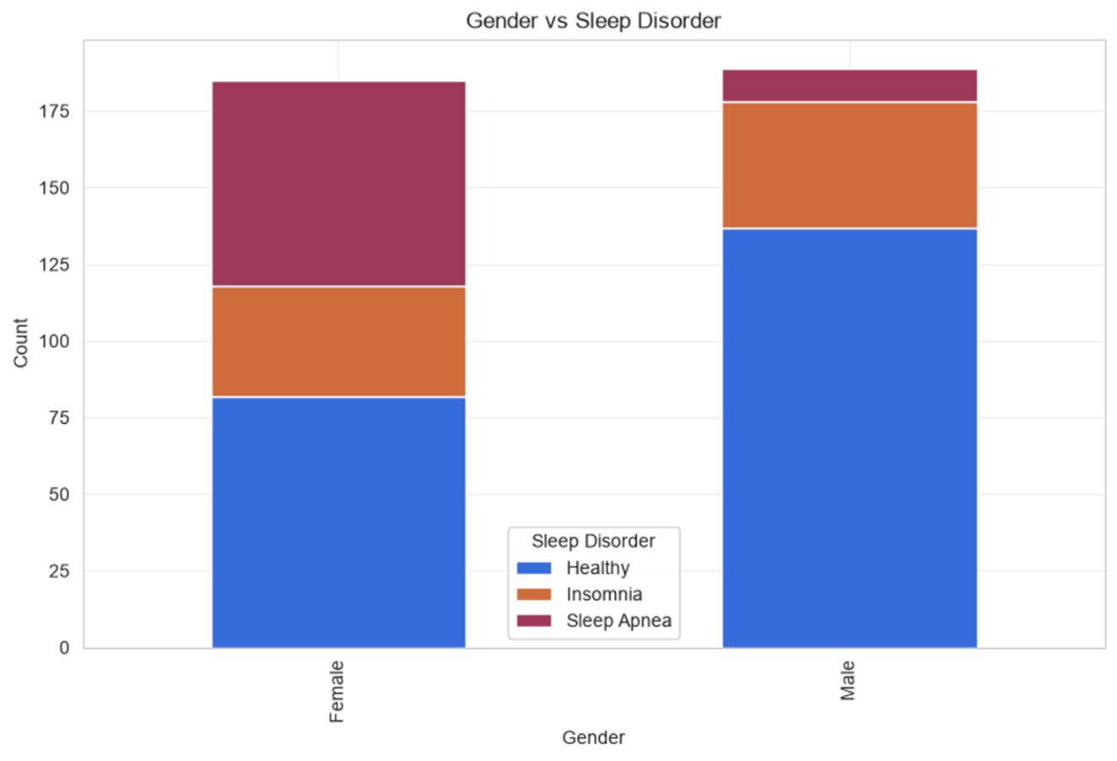
Sleep Disorder Analysis
Healthy individuals form the largest group
Insomnia and Sleep Apnea are significant subsets
Sleep disorders warrant deeper lifestyle correlation analysis
The women are more affected with sleep disorders comparatively to men

Slide 7
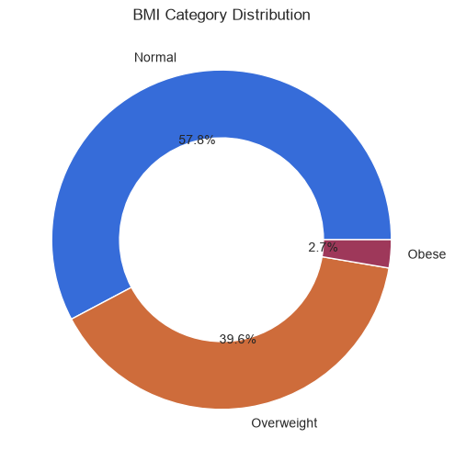
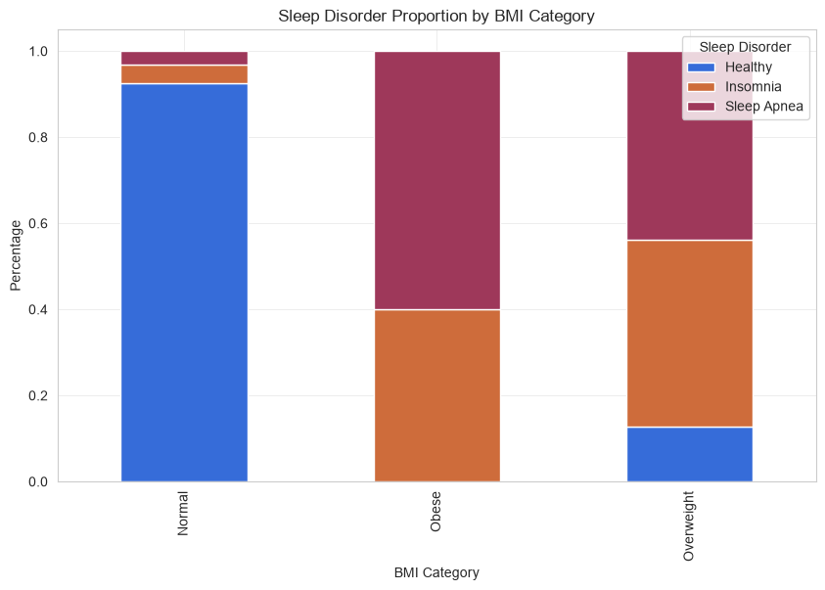
Bmi distribution
Normal BMI is the dominant category
Overweight group represents a large share
Obesity appears linked with poorer health indicators

Slide 8
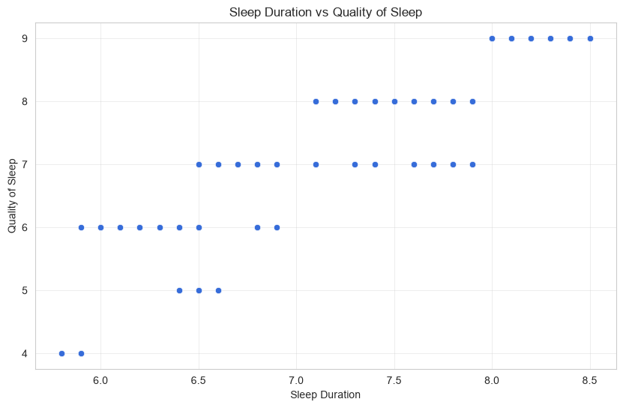
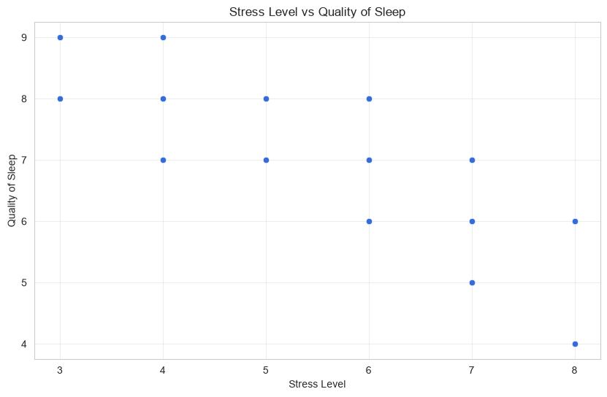
Sleep Duration vs Sleep Quality & stress
Positive relationship observed
Longer sleep generally corresponds to better sleep quality
Poor sleepers cluster around lower sleep duration
Higher stress associated with lower sleep quality
Stress is a major lifestyle factor affecting sleep
Potential target for intervention

Slide 9
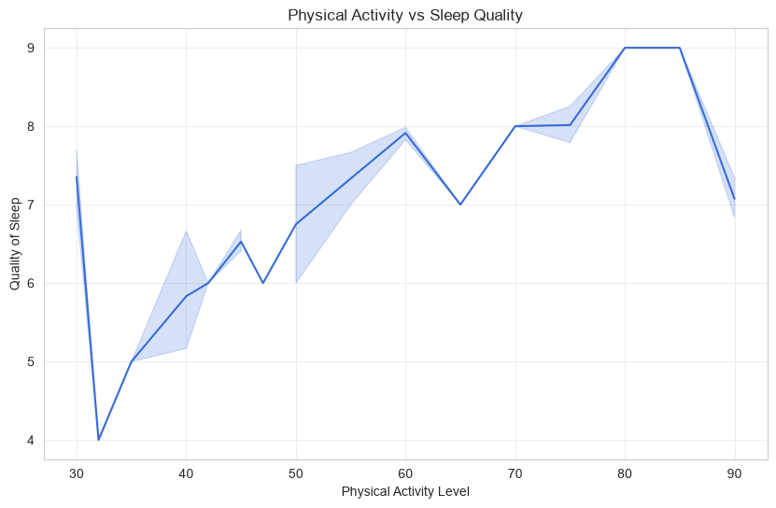
Physical activity vs sleep duration
The study shows that the person with more physical activity has a better sleeping time.

Slide 10
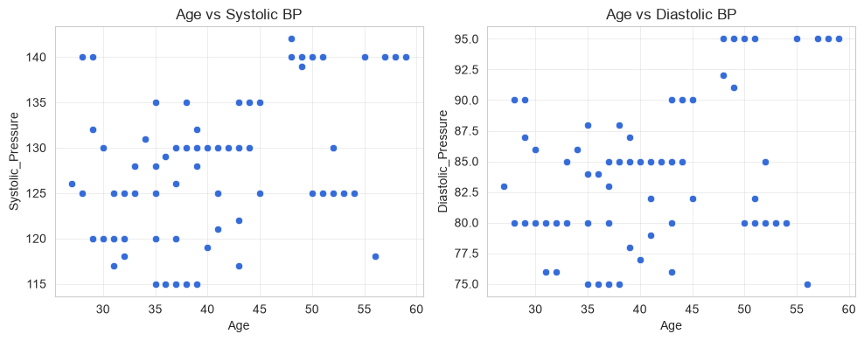
Blood pressure analysis
Older groups tend to show higher systolic pressure
After the age of 35 there are high chances of a person affected with high blood pressure

Slide 11
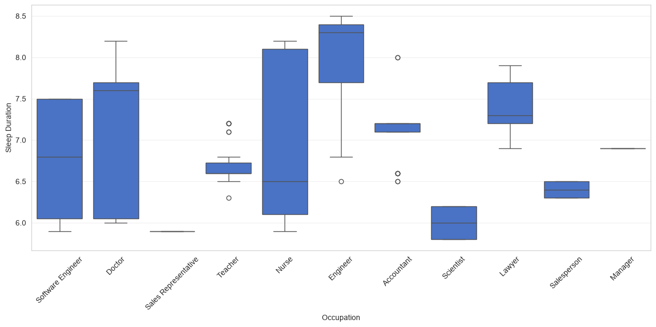
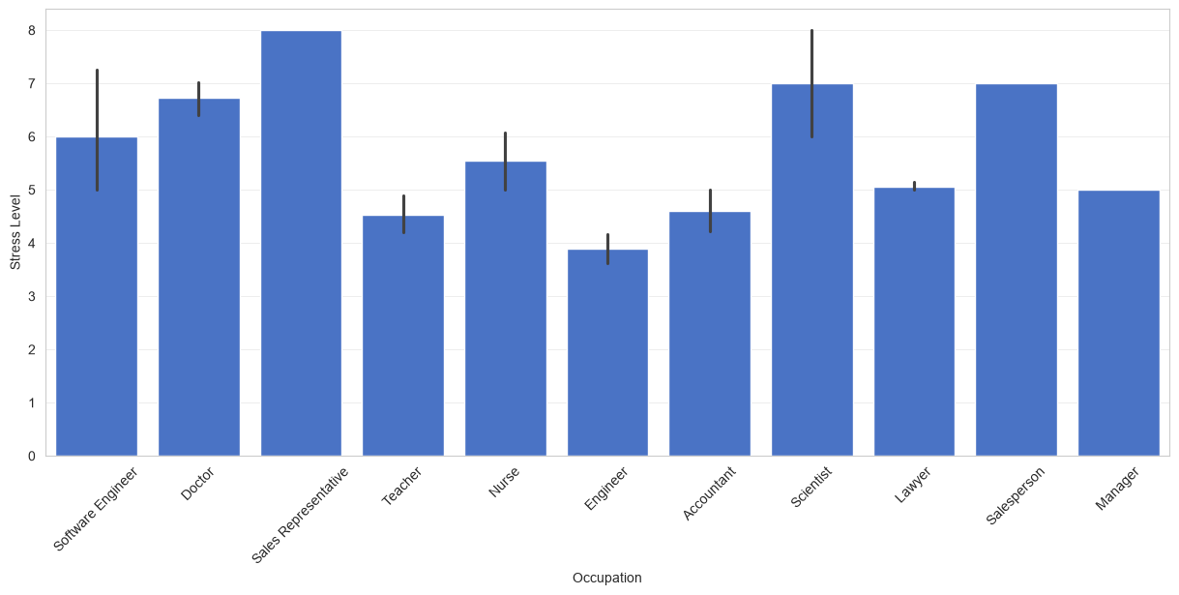
Occupation insights
Doctors, Nurses, Engineers and Teachers show differing patterns
Occupation influences stress and sleep duration
Workload likely contributes to sleep outcomes

Slide 12
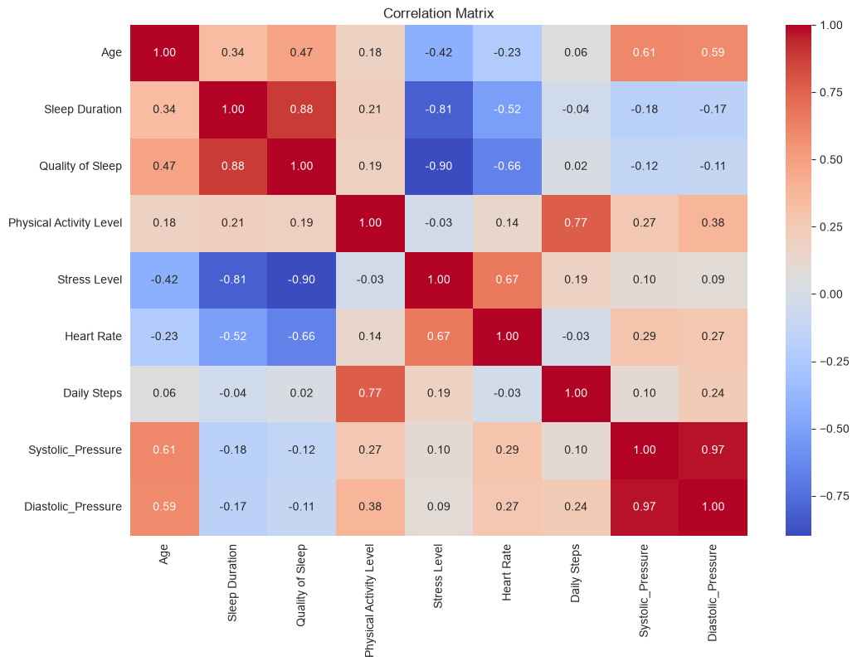
Correlation findings
Sleep Duration positively correlates with Quality of Sleep
Stress negatively impacts sleep metrics
Physical activity and daily steps support better outcomes

Slide 13
Key Conclusions
Sleep quality is shaped by sleep duration, stress and activity
Sleep disorders are associated with poorer health measures
Lifestyle improvements can positively influence sleep health

